Slide 1

Programming Languages
Third Edition
Chapter 7
Basic Semantics

Slide 2
Objectives
Understand attributes, binding, and semantic functions
Understand declarations, blocks, and scope
Learn how to construct a symbol table
Understand name resolution and overloading
Understand allocation, lifetimes, and the environment
Programming Languages, Third Edition

Slide 3
Objectives (cont’d.)
Work with variables and constants
Learn how to handle aliases, dangling references, and garbage
Perform an initial static semantic analysis of TinyAda
Programming Languages, Third Edition

Slide 4
Introduction
Syntax: what the language constructs look like
Semantics: what the language constructs actually do
Specifying semantics is more difficult than specifying syntax
Several ways to specify semantics:
  Language reference manual
  Defining a translator
  Formal definition
Programming Languages, Third Edition

Slide 5
Introduction (cont’d.)
Language reference manual:
  Most common way to specify semantics
  Provides clearer and more precise reference manuals
  Suffers from a lack of precision inherent in natural language descriptions
  May have omissions and ambiguities
Programming Languages, Third Edition

Slide 6
Introduction (cont’d.)
Defining a translator:
  Questions about a language can be answered by experimentation
  Questions about program behavior cannot be answered in advance
  Bugs and machine dependencies in the translator may become part of the language semantics, possibly unintentionally
  May not be portable to all machines
  May not be generally available
Programming Languages, Third Edition

Slide 7
Introduction (cont’d.)
Formal definition:
  Formal mathematical methods: precise, but are also complex and abstract
  Requires study to understand
  Denotational semantics: probably the best formal method for the description of the translation and execution of programs
    Describes semantics using a series of functions
This course will use a hybrid of informal description with the simplified functions used in denotational descriptions
Programming Languages, Third Edition

Slide 8
Attributes, Binding, and Semantic Functions
Names (or identifiers): a fundamental abstraction mechanism used to denote language entities or constructs
Fundamental step in describing semantics is to describe naming conventions for identifiers
Most languages also include concepts of location and value
  Value: any storable quantities
  Location: place where value can be stored; usually a relative location
Programming Languages, Third Edition

Slide 9

Attributes, Binding, and Semantic Functions (cont’d.)
Attributes: properties that determine the meaning of the name to which they are associated
Example in C:
  Attributes for variables and constants include data type and value
Example in C:
  Attributes include “function,” number, names and data type of parameters, return value data type, body of code to be executed
Programming Languages, Third Edition

Slide 10
Attributes, Binding, and Semantic Functions (cont’d.)
Assignment statements associate attributes to names
Example:
  Associates attribute “value 2” to variable x
Example in C++:
  Allocates memory (associates location to y)
  Associates value
Programming Languages, Third Edition

Slide 11
Attributes, Binding, and Semantic Functions (cont’d.)
Binding: process of associating an attribute with a name
Binding time: the time when an attribute is computed and bound to a name
Two categories of binding:
  Static binding: occurs prior to execution
  Dynamic binding: occurs during execution
Static attribute: an attribute that is bound statically
Dynamic attribute: an attribute that is bound dynamically
Programming Languages, Third Edition

Slide 12
Attributes, Binding, and Semantic Functions (cont’d.)
Languages differ substantially in which attributes are bound statically or dynamically
  Functional languages tend to have more dynamic binding than imperative languages
Static attributes can be bound during translation, during linking, or during loading of the program
Dynamic attributes can be bound at different times during execution, such as entry or exit from a procedure or from the program
Programming Languages, Third Edition

Slide 13
Attributes, Binding, and Semantic Functions (cont’d.)
Some attributes are bound prior to translation time
  Predefined identifiers: specified by the language definition
  Values true/false bound to data type Boolean
  maxint specified by language definition and implementation
All binding times except execution time are static binding
Programming Languages, Third Edition

Slide 14
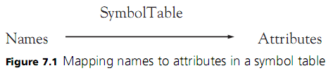
Attributes, Binding, and Semantic Functions (cont’d.)
A translator creates a data structure to maintain bindings
  Can be thought of as a function that expresses the binding of attributes to names
Symbol table: a function from names to attributes
Programming Languages, Third Edition

Slide 15
Attributes, Binding, and Semantic Functions (cont’d.)
Parsing phase of translation includes three types of analysis:
  Lexical analysis: determines whether a string of characters represents a token
  Syntax analysis: determines whether a sequence of tokens represents a phrase in the context-free grammar
  Static semantic analysis: establishes attributes of names in declarations and ensures that the use of these names conforms to their declared attributes
During execution, attributes are also maintained
Programming Languages, Third Edition

Slide 16


Attributes, Binding, and Semantic Functions (cont’d.)
Programming Languages, Third Edition

Slide 17
Declarations, Blocks, and Scope
Bindings can be implicit or explicit
Example:
  Data type is bound explicitly; location of x is bound implicitly
Entire declaration itself may be implicit in languages where simply using the variable name causes it to be declared
Definition: in C and C++, a declaration that binds all potential attributes
Prototype: function declaration that specifies the data type but not the code to implement it
Programming Languages, Third Edition

Slide 18
Declarations, Blocks, and Scope (cont’d.)
Block: a sequence of declarations followed by a sequence of statements
Compound statements: blocks in C that appear as the body of functions or anywhere an ordinary program statement could appear
Local declarations: associated with a block
Nonlocal declarations: associated with surrounding blocks
Block-structured languages allow nesting of blocks and redeclaration of names within nested blocks
Programming Languages, Third Edition

Slide 19
Declarations, Blocks, and Scope (cont’d.)
Each declared name has a lexical address containing a level number and an offset
  Level number starts at 0 and increases into each nested block
Other sources of declarations include:
  A struct definition composed of local (member) declarations
  A class in object-oriented languages
Declarations can be collected into packages (Ada), modules (ML, Haskell, Python), and namespaces (C++)
Programming Languages, Third Edition

Slide 20
Declarations, Blocks, and Scope (cont’d.)
Scope of a binding: region of the program over which the binding is maintained
Lexical scope: in block-structured languages, scope is limited to the block in which its associated declaration appears (and other blocks contained within it)
Declaration before use rule: in C, scope of a declaration extends from the point of declaration to the end of the block in which it is located
Programming Languages, Third Edition

Slide 21
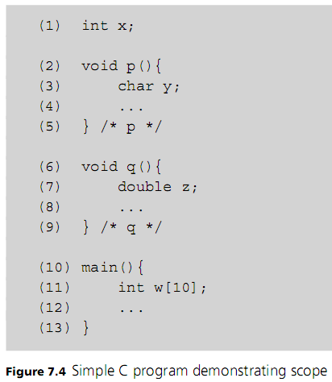
Programming Languages, Third Edition

Slide 22
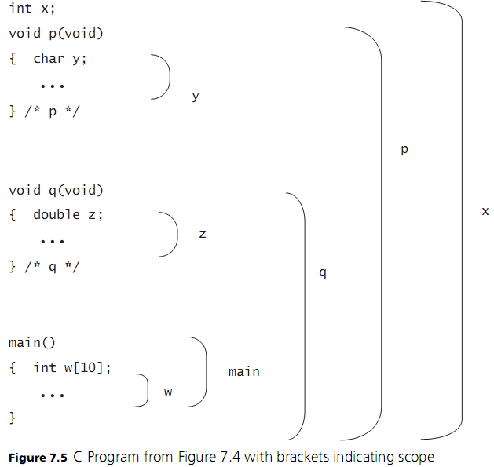
Programming Languages, Third Edition

Slide 23
Declarations, Blocks, and Scope (cont’d.)
Declarations in nested blocks take precedence over previous declarations
A global variable is said to have a scope hole in a block containing a local declaration with the same name
  Use scope resolution operator :: in C++ to access the global variable
Local declaration is said to shadow its global declaration
Visibility: includes only regions where the bindings of a declaration apply
Programming Languages, Third Edition

Slide 24
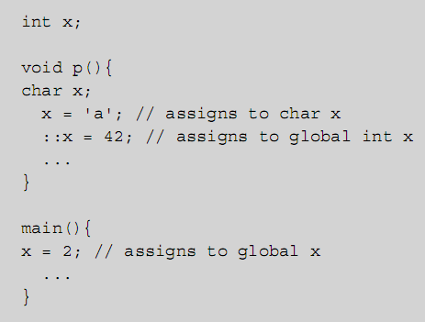
Declarations, Blocks, and Scope (cont’d.)
Programming Languages, Third Edition

Slide 25
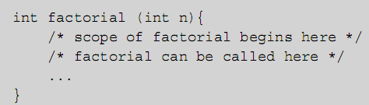
Declarations, Blocks, and Scope (cont’d.)
Scope rules need to be constructed such that recursive (self-referential) declarations are possible when they make sense
  Example: functions must be allowed to be recursive, so function name must have scope beginning before the block of the function body
Programming Languages, Third Edition

Slide 26
The Symbol Table
Symbol table:
  Must support insertion, lookup, and deletion of names with associated attributes, representing bindings in declarations
A lexically scoped, block-structured language requires a stack-like data structure to perform scope analysis:
  On block entry, all declarations of that block are processed and bindings added to symbol table
  On block exit, bindings are removed, restoring any previous bindings that may have existed
Programming Languages, Third Edition

Slide 27
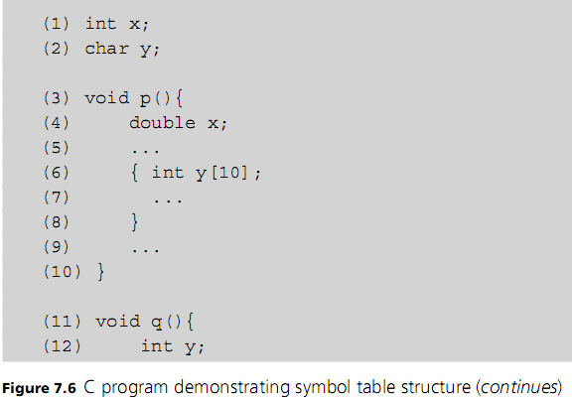
Programming Languages, Third Edition

Slide 28
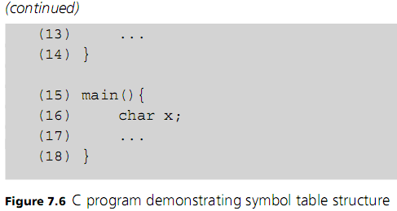
The Symbol Table (cont’d.)
Programming Languages, Third Edition

Slide 29
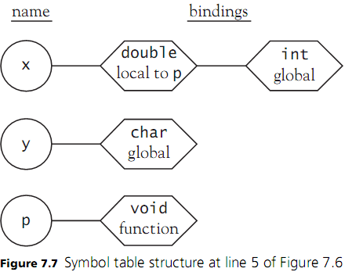
The Symbol Table (cont’d.)
Programming Languages, Third Edition

Slide 30
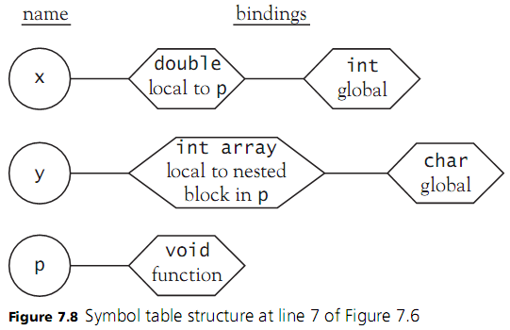
The Symbol Table (cont’d.)
Programming Languages, Third Edition

Slide 31
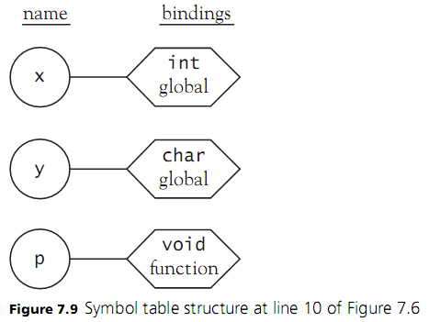
The Symbol Table (cont’d.)
Programming Languages, Third Edition

Slide 32
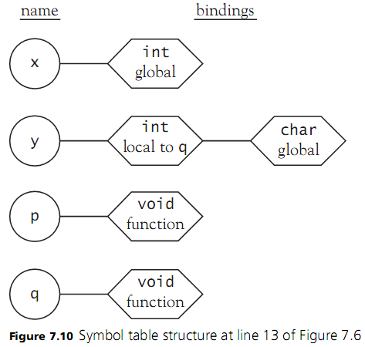
The Symbol Table (cont’d.)
Programming Languages, Third Edition

Slide 33
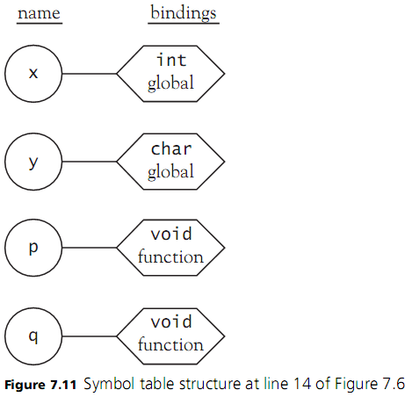
The Symbol Table (cont’d.)
Programming Languages, Third Edition

Slide 34
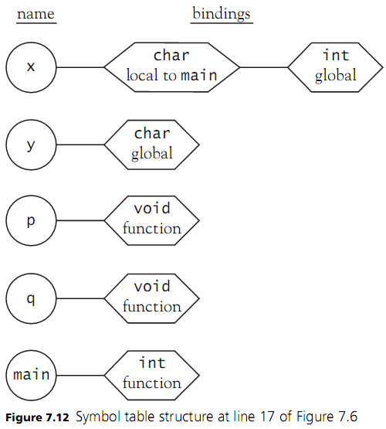
Programming Languages, Third Edition

Slide 35
The Symbol Table (cont’d.)
The previous example assumes that declarations are processed statically (prior to execution)
  This is called static scoping or lexical scoping
  Symbol table is managed by a compiler
  Bindings of declarations are all static
If symbol table is managed dynamically (during execution), declarations will be processed as they are encountered along an execution path
  This is called dynamic scoping
Programming Languages, Third Edition

Slide 36
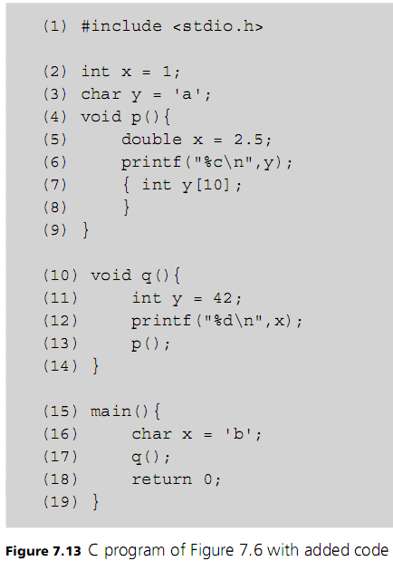
Programming Languages, Third Edition

Slide 37
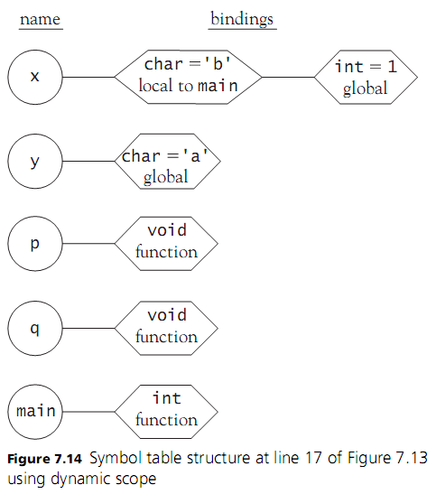
Programming Languages, Third Edition

Slide 38
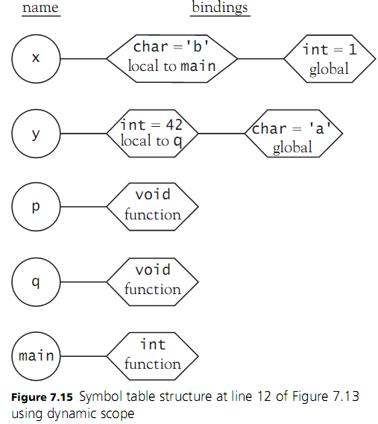
Programming Languages, Third Edition

Slide 39
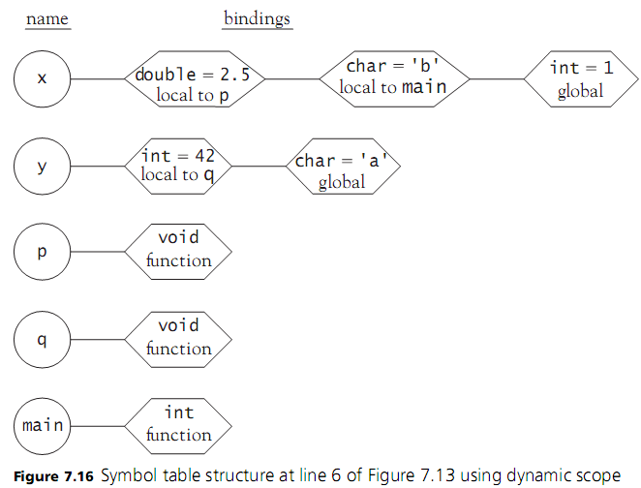
Programming Languages, Third Edition

Slide 40


The Symbol Table (cont’d.)
Dynamic scoping will affect the semantics of the program and produce different output
Output using lexical scoping:
Output using dynamic scoping:
Dynamic scope can be problematic, which is why few languages use it
Programming Languages, Third Edition

Slide 41
The Symbol Table (cont’d.)
Problems with dynamic scoping:
  The declaration of a nonlocal name cannot be determined by simply reading the program: the program must be executed to know the execution path
  Since nonlocal variable references cannot be predicted prior to execution, neither can their data types
Dynamic scoping is a possible option for highly dynamic, interpreted languages when programs are not expected to be extremely large
Programming Languages, Third Edition

Slide 42
The Symbol Table (cont’d.)
Runtime environment is simpler with dynamic scoping in an interpreter
  APL, Snobol, Perl, and early dialects of Lisp were dynamically scoped
  Scheme and Common Lisp use static scoping
There is additional complexity for symbol tables
struct declaration must contain further declarations of the data fields within it
  Those fields must be accessible using dot member notation whenever the struct variable is in scope
Programming Languages, Third Edition

Slide 43
The Symbol Table (cont’d.)
Two implications for struct variables:
  A struct declaration actually contains a local symbol table itself as an attribute
  This local symbol table cannot be deleted until the struct variable itself is deleted from the global symbol table of the program
Programming Languages, Third Edition

Slide 44
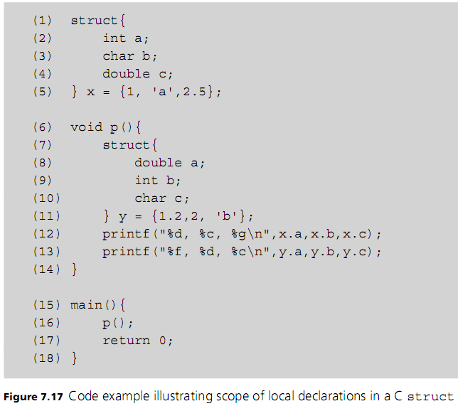
Programming Languages, Third Edition

Slide 45
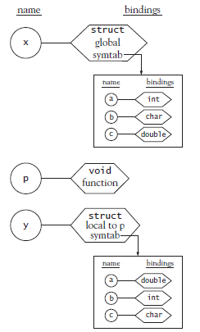
Programming Languages, Third Edition

Slide 46
The Symbol Table (cont’d.)
Any scoping structure that can be referenced directly must also have its own symbol table
Examples:
  Named scopes in Ada
  Classes, structs, and namespaces in C++
  Classes and packages in Java
Typically, there will be a table for each scope in a stack of symbol tables
  When a reference to a name occurs, a search begins in the current table and continues to the next table if not found, and so on
Programming Languages, Third Edition

Slide 47
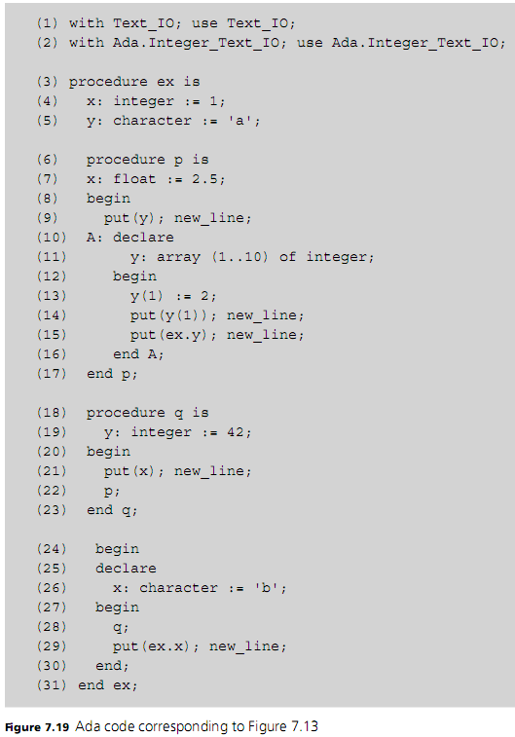
Programming Languages, Third Edition

Slide 48
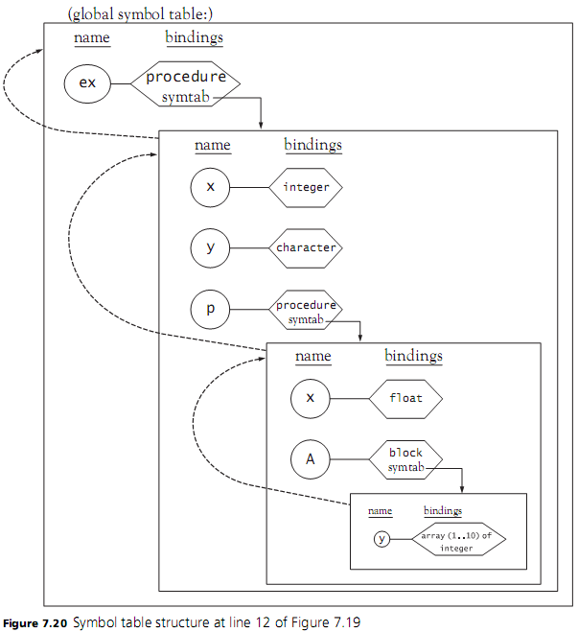
Programming Languages, Third Edition

Slide 49
Name Resolution and Overloading
Addition operator + actually indicates at least two different operations: integer addition and floating-point addition
  + operator is said to be overloaded
Translator must look at the data type of each operand to determine which operation is indicated
Overload resolution: process of choosing a unique function among many with the same name
  Lookup operation of a symbol table must search on name plus number and data type of parameters
Programming Languages, Third Edition

Slide 50
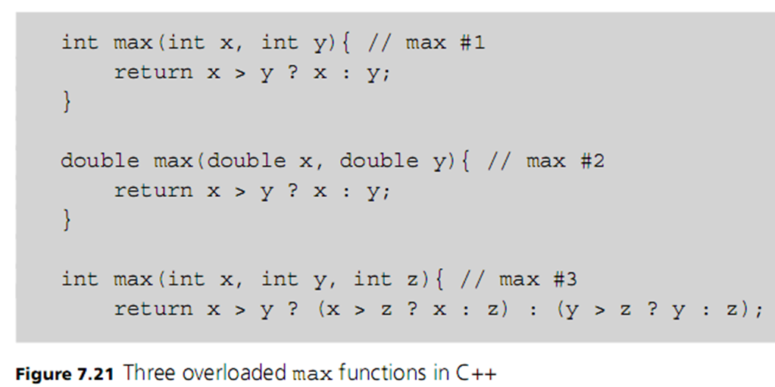
Name Resolution and Overloading (cont’d.)
Programming Languages, Third Edition

Slide 51

Name Resolution and Overloading (cont’d.)
Consider these function calls:
Symbol table can determine the appropriate function based on number and type of parameters
Calling context: the information contained in each call
But this ambiguous call depends on the language rules (if any) for converting between data types:
Programming Languages, Third Edition

Slide 52
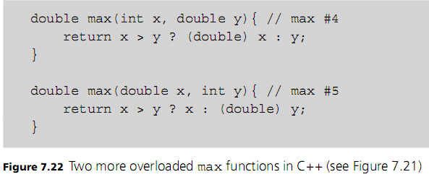
Name Resolution and Overloading (cont’d.)
Adding these definitions makes the function calls legal in C++ and Ada but is unnecessary in Java
Automatic conversions as they exist in C++ and Java significantly complicate overload resolution
Programming Languages, Third Edition

Slide 53
Name Resolution and Overloading (cont’d.)
Additional information in a calling context may be used for overload resolution:
  Ada allows the return type and names of parameters to be used for overhead resolution
  C++ and Java ignore the return type
Both Ada and C++ (but not Java) allow built-in operators to be overloaded
When overloading a built-in operator, we must accept its syntactic properties
  Example: cannot change the associativity or precedence of the + operator
Programming Languages, Third Edition

Slide 54
Name Resolution and Overloading (cont’d.)
Note that there is no semantic difference between operators and functions, only syntactic difference
  Operators are written in infix form
  Function calls are always written in prefix form
Names can also be overloaded
Some languages use different symbol tables for each of the major kinds of definitions to allow the same name for a type, a function, and a variable
  Example: Java
Programming Languages, Third Edition

Slide 55
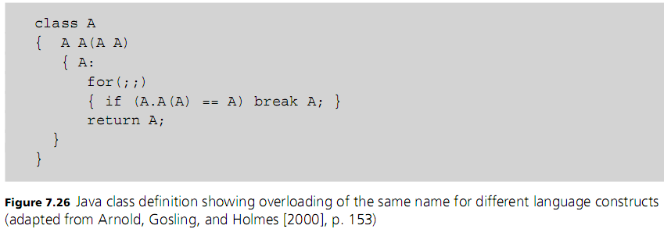
Name Resolution and Overloading (cont’d.)
Programming Languages, Third Edition

Slide 56
Allocation, Lifetimes, and the Environment
Environment: maintains the bindings of names to locations
  May be constructed statically (at load time), dynamically (at execution time), or with a mixture of both
Not all names in a program are bound to locations
  Examples: names of constants and data types may represent purely compile-time quantities
Declarations are also used in environment construction
  Indicate what allocation code must be generated
Programming Languages, Third Edition

Slide 57
Allocation, Lifetimes, and the Environment (cont’d.)
Typically, in a block-structured language:
  Global variables are allocated statically
  Local variables are allocated dynamically when the block is entered
When a block is entered, memory for variables declared in that block is allocated
When a block is exited, this memory is deallocated
Programming Languages, Third Edition

Slide 58
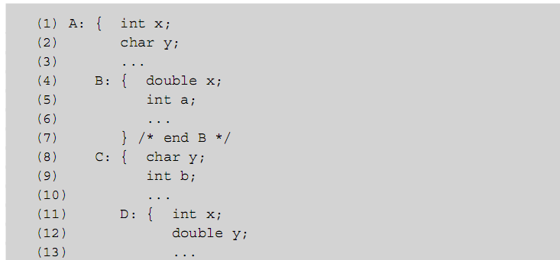
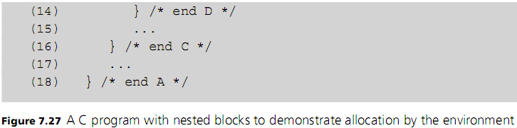
Programming Languages, Third Edition

Slide 59
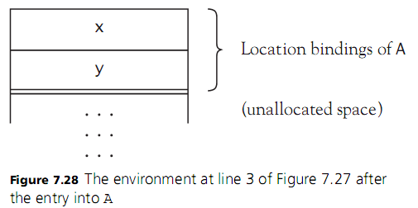
Allocation, Lifetimes, and the Environment (cont’d.)
Programming Languages, Third Edition

Slide 60
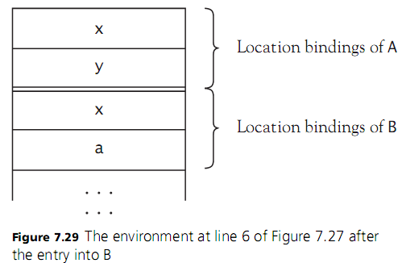
Allocation, Lifetimes, and the Environment (cont’d.)
Programming Languages, Third Edition

Slide 61
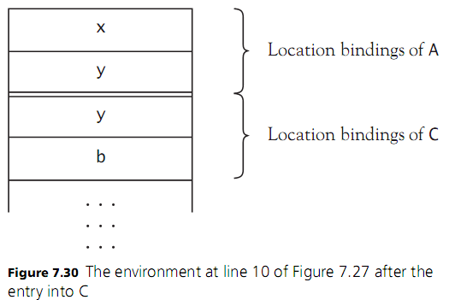
Allocation, Lifetimes, and the Environment (cont’d.)
Programming Languages, Third Edition

Slide 62
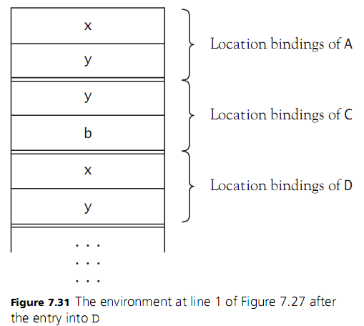
Allocation, Lifetimes, and the Environment (cont’d.)
Programming Languages, Third Edition

Slide 63
Allocation, Lifetimes, and the Environment (cont’d.)
Memory for local variables within a function will not be allocated until the function is called
Activation: a call to a function
Activation record: the corresponding region of allocated memory
In a block-structured language with lexical scope, the same name can be associated with different locations, but only one of these can be accessed at any one time
Lifetime (or extent) of an object is the duration of its allocation in the environment
Programming Languages, Third Edition

Slide 64
Allocation, Lifetimes, and the Environment (cont’d.)
Lifetime of an object can extend beyond the region of a program in which it can be accessed
  Lifetime extends through a scope hole
Pointer: an object whose stored value is a reference to another object
C allows the initialization of pointers that do not point to an allocated object:
  Objects must be manually allocated by use of an allocation routine
  Variable can be dereferenced using the unary * operator
Programming Languages, Third Edition

Slide 65
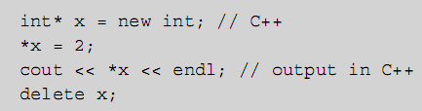
Allocation, Lifetimes, and the Environment (cont’d.)
C++ simplifies dynamic allocation with operators new and delete:
  These are used as unary operators, not functions
Heap: area in memory from which locations can be allocated in response to calls to new
Dynamic allocation: allocation on the heap
Programming Languages, Third Edition

Slide 66
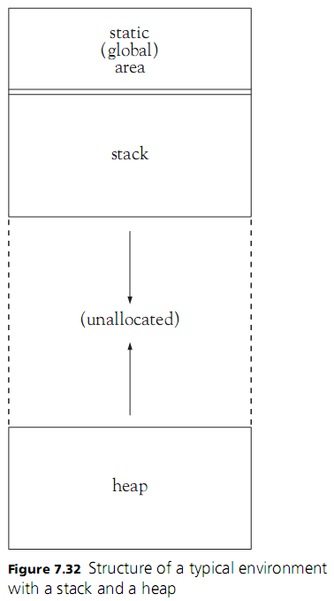
Programming Languages, Third Edition

Slide 67
Allocation, Lifetimes, and the Environment (cont’d.)
Many languages require that heap deallocation be managed automatically
Heap allocation/deallocation and explicit pointer manipulation are inherently unsafe operations
  Can introduce seriously faulty runtime behavior that may even compromise the operating system
Storage class: the type of allocation
  Static (for global variables)
  Automatic (for local variables)
  Dynamic (for heap allocation)
Programming Languages, Third Edition

Slide 68
Variables and Constants
Although references to variables and constants look the same in many languages, their roles and semantics are very different
We will look at the basic semantics of both
Programming Languages, Third Edition

Slide 69
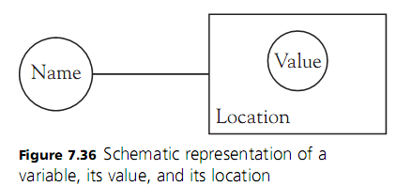
Variables
Variable: an object whose stored value can change during execution
  Is completely specified by its attributes (name, location, value, data type, size of memory storage)
Box and circle diagram: focuses on name and location
Programming Languages, Third Edition

Slide 70
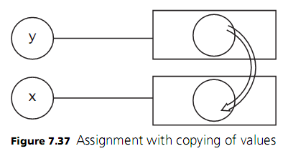
Variables (cont’d.)
Assignment statement: principle way in which a variable changes its value
Example:
  Semantics: expression e is evaluated to a value, then copied into the location of x
If e is a variable named y:
Programming Languages, Third Edition

Slide 71
Variables (cont’d.)
Variable on right side of assignment statement stands for a value (r-value); variable on left side stands for a location (l-value)
Address of operator (&) in C: turns a reference into a pointer to fetch the address of a variable
Assignment by sharing: the location is copied instead of the value
Assignment by cloning: allocates new location, copies value, and binds to the new location
Both are sometimes called pointer semantics or reference semantics
Programming Languages, Third Edition

Slide 72
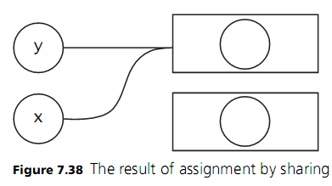
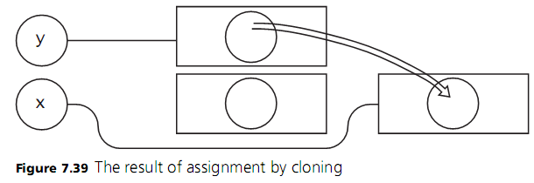
Variables (cont’d.)
Programming Languages, Third Edition

Slide 73
Variables (cont’d.)
Storage semantics or value semantics refer to standard assignment
Standard implementation of assignment by sharing uses pointers and implicit dereferencing
Programming Languages, Third Edition

Slide 74

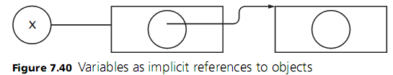

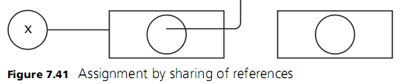
Variables (cont’d.)
Programming Languages, Third Edition

Slide 75
Constants
Constant: an entity with a fixed value for the duration of its existence in a program
  Like a variable, but has no location attribute
  Sometimes say that a constant has value semantics
Literal: a representation of characters or digits
Compile-time constant: its value can be computed during compilation
Static constant: its value can be computed at load time
Programming Languages, Third Edition

Slide 76
Constants (cont’d.)
Manifest constant: a name for a literal
Dynamic constant: its value must be computed during execution
Function definitions in virtually all languages are definitions of constants whose values are functions
  This differs from a function variable in C, which must be defined as a pointer
Programming Languages, Third Edition

Slide 77
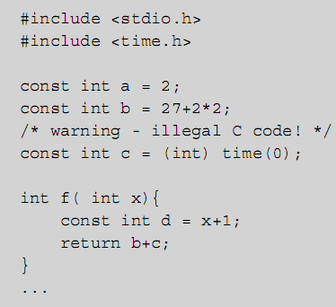
Constants (cont’d.)
a and b are compile-time constants
  a is a manifest constant
c is a static (load-time constant)
d is a dynamic constant
Programming Languages, Third Edition

Slide 78
Aliases, Dangling References, and Garbage
There are several problems with naming and dynamic allocation conventions of programming languages, especially C, C++, and Ada
As a programmer, you can learn to avoid those problematic situations
As a language designer, you can build solutions into your language
Programming Languages, Third Edition

Slide 79
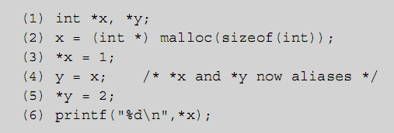
Aliases
Alias: occurs when the same object is bound to two different names at the same time
Can occur during procedure call, through the use of pointer variables, or through assignment by sharing
Programming Languages, Third Edition

Slide 80
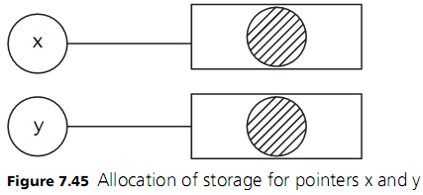
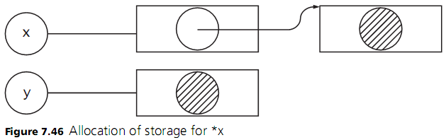
Aliases (cont’d.)
Programming Languages, Third Edition

Slide 81
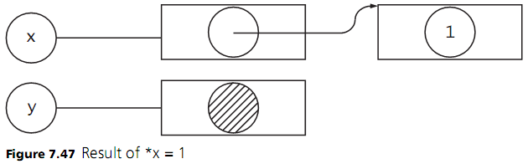
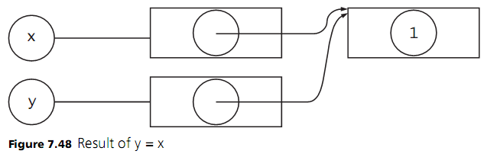
Aliases (cont’d.)
Programming Languages, Third Edition

Slide 82
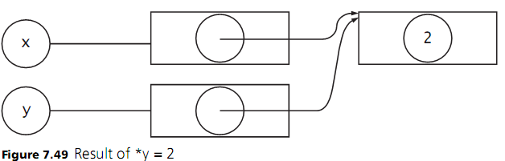
Aliases (cont’d.)
Programming Languages, Third Edition

Slide 83
Aliases (cont’d.)
Aliases can potentially cause harmful side effects
Side effect: any change in a variable’s value that persists beyond the execution of the statement
Not all side effects are harmful; an assignment statement is intended to cause one
Side effects that change variables whose names do not directly appear in the statement are potentially harmful
  Cannot be determined from the written code
Aliasing due to pointer assignment is difficult to control
Programming Languages, Third Edition

Slide 84
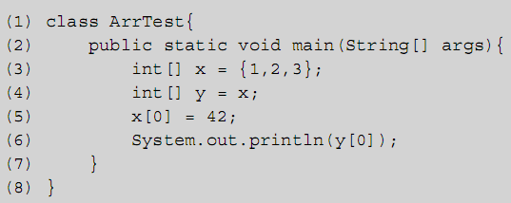
Aliases (cont’d.)
Assignment by sharing implicitly uses pointers
Java has a mechanism for explicitly cloning an object so that aliases are not created by assignment
Programming Languages, Third Edition

Slide 85
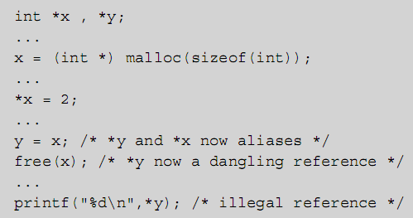
Dangling References
Dangling reference: a location that has been deallocated from the environment but can still be accessed by a program
  Occurs when a pointer points to a deallocated object
Programming Languages, Third Edition

Slide 86
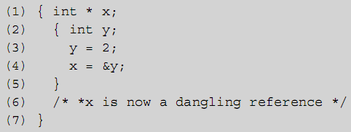
Dangling References (cont’d.)
Can also result from automatic deallocation of local variables on exit from a block, with the C address of operator
Programming Languages, Third Edition

Slide 87
Dangling References (cont’d.)
Java does not allow dangling references at all because:
  There are no explicit pointers
  There is no address of operator
  There are no memory deallocation operators such as free or delete
Programming Languages, Third Edition

Slide 88
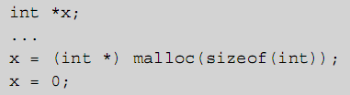
Garbage
Garbage: memory that has been allocated in the environment but is now inaccessible to the program
Can occur in C by failing to call free before reassigning a pointer variable
A program that is internally correct but produces garbage may run out of memory
Programming Languages, Third Edition

Slide 89
Garbage (cont’d.)
A program with dangling references may:
  Produce incorrect results
  Corrupt other programs in memory
  Cause runtime errors that are hard to locate
For this reason, it is useful to remove the need to deallocate memory explicitly from the programmer
Garbage collection: process of automatically reclaiming garbage
Language design is a key factor in the kind of runtime environment necessary for correct execution of programs
Programming Languages, Third Edition

Slide 90
Case Study: Initial Static Semantic Analysis of TinyAda
Chapter 6 introduced a syntax analyzer for TinyAda
  A simple parsing shell that pulled tokens from a scanner until a syntax error was detected
Here, we extend the parsing shell to perform some semantic analysis
  Focus will be on tools for scope analysis and for restricting the use of identifiers
Must focus on two attributes of an identifier:
  Name
  Role it plays (constant, variable, type, or procedure)
Programming Languages, Third Edition

Slide 91
Scope Analysis
TinyAda is lexically scoped, with these scope rules:
  All identifiers must be declared before use
  At most, one declaration for a given identifier in a single block
  A new block starts with formal parameter specifications of a procedure and extends to the reserved word end
  Visibility of a declared identifier extends into nested blocks unless it is redeclared in that block
  Identifiers are not case sensitive
Programming Languages, Third Edition

Slide 92
Scope Analysis (cont’d.)
TinyAda has five built-in (predefined) identifiers:
  Data type names integer, char, boolean
  Boolean constants true and false
These identifiers must be visible in a top-level scope before a source program is parsed
  Static nesting level of this scope is 0
Scope at nesting level 1 contains the procedure’s formal parameters (if any) and any identifiers introduced in the procedures basic declarations
Names in nested procedures follow this pattern
Programming Languages, Third Edition

Slide 93
Scope Analysis (cont’d.)
TinyAda’s parser uses a stack of symbol tables
  When each new scope is entered, a new table is pushed onto the stack
  When a scope is exited, the table at the top of the stack is popped off the stack
Two classes are defined to support scope analysis:
  SymbolEntry: holds information about an identifier
  SymbolTable: manages the stack of scopes
Programming Languages, Third Edition

Slide 94
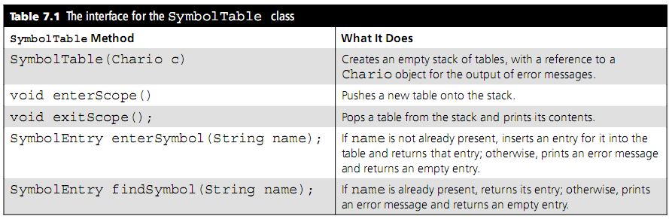
Scope Analysis (cont’d.)
Programming Languages, Third Edition

Slide 95
Identifier Role Analysis
An identifier names an entity, such as a variable, a constant, or an entire data type
  This attribute of an identifier is called its role
An identifier’s role imposes certain restrictions on its use
Examples:
  Only a variable or parameter identifier can appear on the left side of an assignment statement
  Only a type identifier can appear as the element type of an array
Programming Languages, Third Edition

Slide 96
Identifier Role Analysis (cont’d.)
Identifier acquires its role in its declaration
  Role is saved in the symbol table for future use
Role analysis uses the symbol table to share contextual information about identifiers among otherwise independent parsing methods
Programming Languages, Third Edition

